Slide 1
Learning Lower-Dimensional Representations -PCA

Slide 2
Introduction
The larger the input vector, the larger our model.
Large models with lots of parameters are expressive, but they’re also increasingly data hungry. This means that without sufficiently large volumes of training data, we will likely overfit.
Convolutional architectures help us cope with the curse of dimensionality by reducing the number of parameters in our models without necessarily diminishing expressiveness.

Slide 3
But, convolutional networks still require large amounts of labeled training data.
And for many problems, labeled data is scarce and expensive to generate.
This problem will be handled by developing effective learning models in situations where labeled data is scarce but wild, unlabeled data is plentiful.
In auto encoders, embeddings, or low-dimensional representations, are learnt in an unsupervised fashion.
we can use the generated embeddings to solve learning problems using smaller models that require less data.

Slide 4
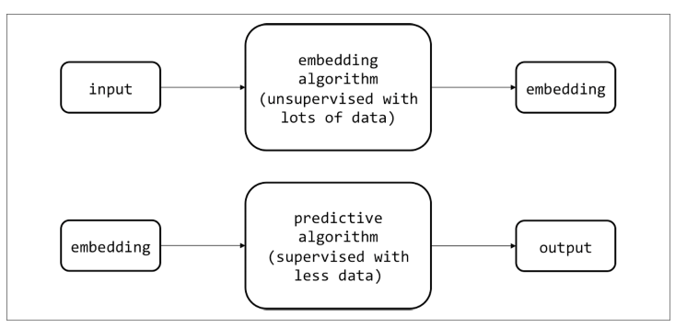
This process is summarized in the following diagram:

Slide 5
Principal Component Analysis
A classic method for dimensionality reduction.
It finds principal components, the underlying structure in the data. They are the directions where there is the most variance, the directions where the data is most spread out.
PCA reduces the dimensionality of large data sets, by transforming a large set of variables into a smaller one that still contains most of the information in the large set.
The basic concept behind PCA is to find a set of axes that communicates the most information about our dataset.
If we have d dimensional data, we’d like to find a new set of m< d
dimensions that conserves as much valuable information from the
original dataset.

Slide 6
Assuming that variance corresponds to information, we can perform this transformation through an iterative process.
First we find a unit vector along which the dataset has maximum variance.
Because this direction contains the most information, we select this direction as our first axis.
For simplicity, let’s choose d = 2, m = 1
So, we have to transform a 2 dimensional representation of data points to a one dimensional representation.
We can transform 2 dimensional data points to one dimensional data points by projecting them on 1 dimensional space i.e. a straight line. (A straight line is one dimensional).

Slide 7
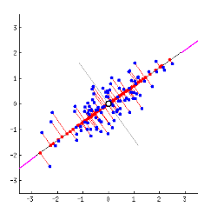
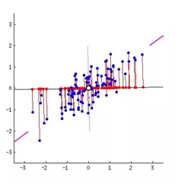
Example Our new data points will be the projections (red points) of those original blue data points.

Slide 8
Finding the first principal axis
The red lines (connecting the projection of blue points on magenta line) i.e. the perpendicular distance of each data point from the straight line is the projection error.
Sum of the error of all data points will be the total projection error.
There can be many straight lines possible.
Clearly, Second choice of straight line in magenta color is better because * The projection error is less than that in the first case. * Newly projected red points are more widely spread out than the first case. i.e. more variance.
That magenta straight line is called principal axis.

Slide 9
Then from the set of vectors orthogonal to this first choice, we pick a new unit vector along which the dataset has maximum variance.
This is our second axis. We continue this process until we have found a total of d new vectors that represent new axes. We project our data onto this new set of axes.
We then decide a good value for m and toss out all but the first m axes (the principal components, which store the most information).

Slide 10
From mathematical point, we can view this operation as a project onto the vector space spanned by the top m eigenvectors of the dataset’s covariance matrix (within constant scaling).
Let us represent the dataset as a matrix X with dimensions n × d
(i.e., n inputs of d dimensions).
We’d like to create an embedding matrix T with dimensions n × m
We can compute the matrix using the relationship T = X, where
each column of W corresponds to an eigenvector of the matrix
X^{T}X

Slide 11
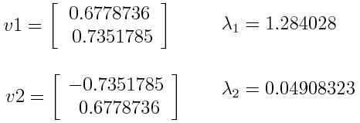
Example
Suppose that our data set is 2-dimensional with 2 variables x,y and that the eigenvectors and eigenvalues of the covariance matrix are as follows:

Slide 12
If we rank the eigenvalues in descending order, we get λ1>λ2, which means that the eigenvector that corresponds to the first principal component (PC1) is v1 and the one that corresponds to the second component (PC2) isv2.
After having the principal components, to compute the percentage of variance (information) accounted for by each component, we divide the eigenvalue of each component by the sum of eigenvalues. If we apply this on the example above, we find that PC1 and PC2 carry respectively 96% and 4% of the variance of the data.
we can either form a feature vector with both of the eigenvectors v1 and v2. Or discard the eigenvector v2, which is the one of lesser significance.
Discarding the eigenvector v2 will reduce dimensionality by 1, and will consequently cause a loss of information in the final data set. But given that v2 was carrying only 4% of the information, the loss will be therefore not important and we will still have 96% of the information that is carried by v1.

Slide 13
Last step:
use the feature vector formed using the eigenvectors of the covariance matrix, to reorient the data from the original axes to the ones represented by the principal components (hence the name Principal Components Analysis). This can be done by multiplying the transpose of the original data set by the transpose of the feature vector.

Slide 14
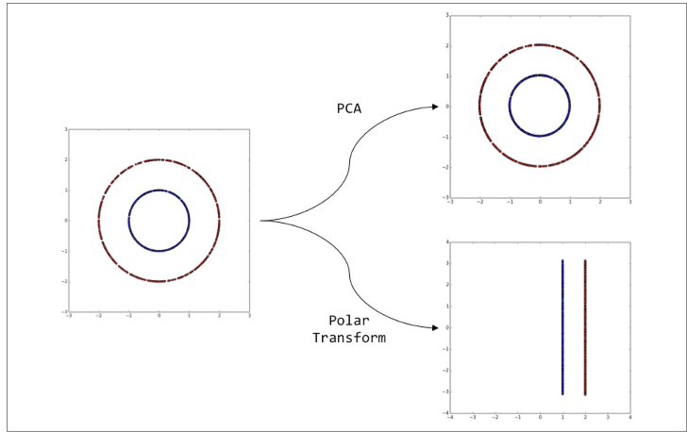
A situation where PCA fails PCA is not suitable in many cases: For example, if all the components of PCA have quite a high variance, there is no 'good' universal stopping rule that allows you to discard some exact 'k' Principal Components, with a guarantee that there will be no 'significant' ( for your application) loss of data in the compression.

Slide 15
Motivating the Autoencoder Architecture
PCA fails to capturing important relationships in complex datasets.
Most of the datasets images, text, etc. are characterized by nonlinear relationships, we must develop a theory that will perform nonlinear dimensionality reduction.
In feed-forward networks, each layer learns progressively more relevant representations of the input.
There are fundamental problems with supervised approaches in general. Specifically, while the selected layer does contain information from the input, the network has been trained to pay attention to the aspects of the input that are critical to solving the task at hand.
As a result, there’s a significant amount of information loss with respect to elements of the input that may be important for other classification tasks, but potentially less important than the one immediately at hand.

Slide 16
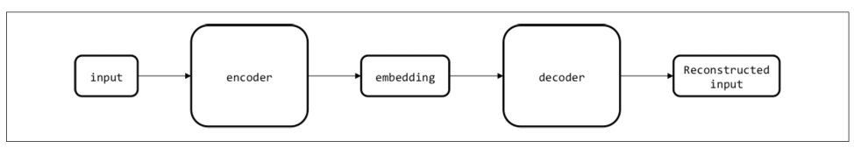
Autoencoder
We first take the input and compress it into a low-dimensional vector.
This part of the network is called the encoder because it is responsible for producing the low-dimensional embedding or code.
The second part of the network, instead of mapping the embedding to an arbitrary label as we would in a feed-forward network, tries to invert the computation of the first half of the network and reconstruct the original input. This piece is known as the decoder.

Slide 17
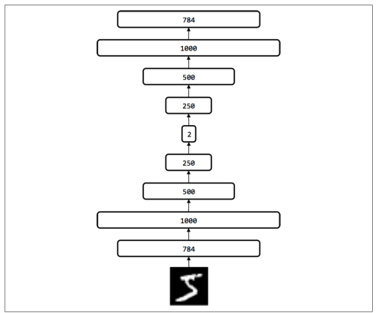
The experimental setup for dimensionality reduction of the MNIST dataset

Slide 18
references
https://medium.com/@aptrishu/understanding-principle-component-analysis-e32be0253ef0
https://builtin.com/data-science/step-step-explanation-principal-component-analysis

